Slide 1


Slide 2
valdis iljuconoks
(aka technical fellow)

Slide 3




valdis iljuconoks (aka technical fellow)
tech fellow at getadigital.com
(Microsoft .Net + EPiServer) ◦ MVP
@tech_fellow

Slide 4
Azure Functions + Cognitive Services = Love Story
Notes:
https://martinfowler.com/articles/serverless.html

Slide 5
Serverless?
Notes:
H
It’s a horrible naming. Of course there is a server, but you just don’t manage that.
There is no magic – somebody else is managing the servers and you instantly get runtimes to host/run you code.

Slide 6
"Serverless is to servers as JavaScript is to Java."
-- Dave Cheney

Slide 7
Azure Serverless Components

Slide 8



Event Grid
Logic Apps
Functions
Serverless Events
Serverless Workflow
Serverless Compute
Notes:
Simplify your event-based apps with Event Grid, a single service for managing routing of all events from any source to any destination. Designed for high availability, consistent performance, and dynamic scale, Event Grid lets you focus on your app logic rather than infrastructure.

Slide 9
Azure Functions is a serverless compute service that enables you to run code on-demand without having to explicitly provision or manage infrastructure.
Use Azure Functions to run a script or piece of code in response to a variety of events.
Notes:
H

Slide 10
Azure Functions is a serverless compute service that enables you to run code on-demand without having to explicitly provision or manage infrastructure.
Use Azure Functions to run a script or piece of code in response to a variety of events.
Notes:
H
Running server applications without managing infra
Has concrete restrictions
Deployments are different
H-scaling is done automatically
Triggered by events (binding)

Slide 11
Start in Portal (sandbox)
C#, F#, node.js, Python, PHP, Batch and more
Schedule event driven tasks
Expose as API endpoints
Auto-scaling (Horiz.)
Notes:
Henrik do this while Valdish show the portal

Slide 12
Use Case Study
Notes:
H

Slide 13


Slide 14
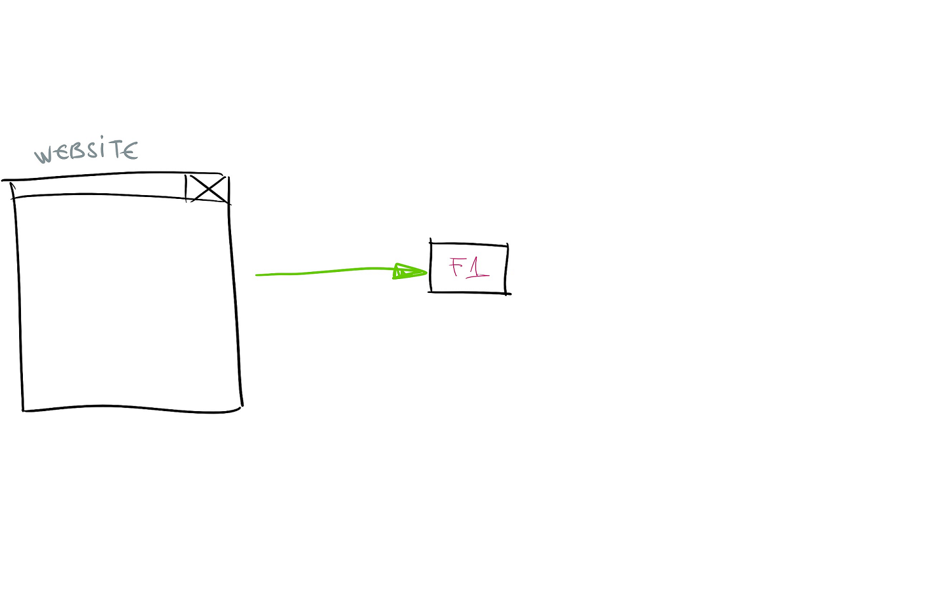

Slide 15
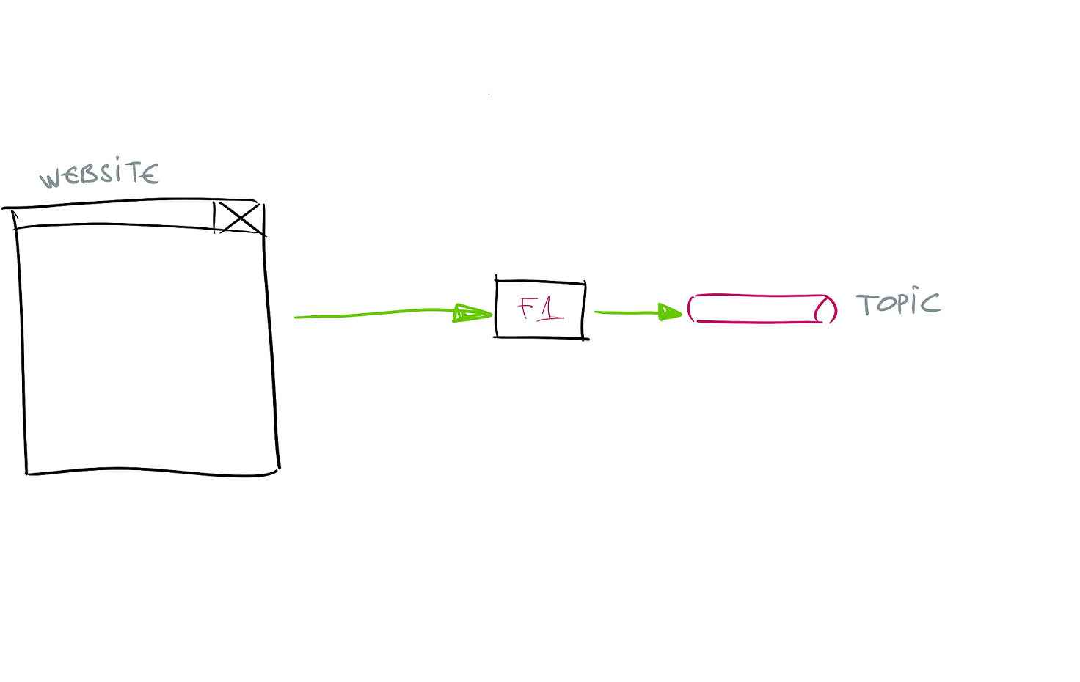

Slide 16
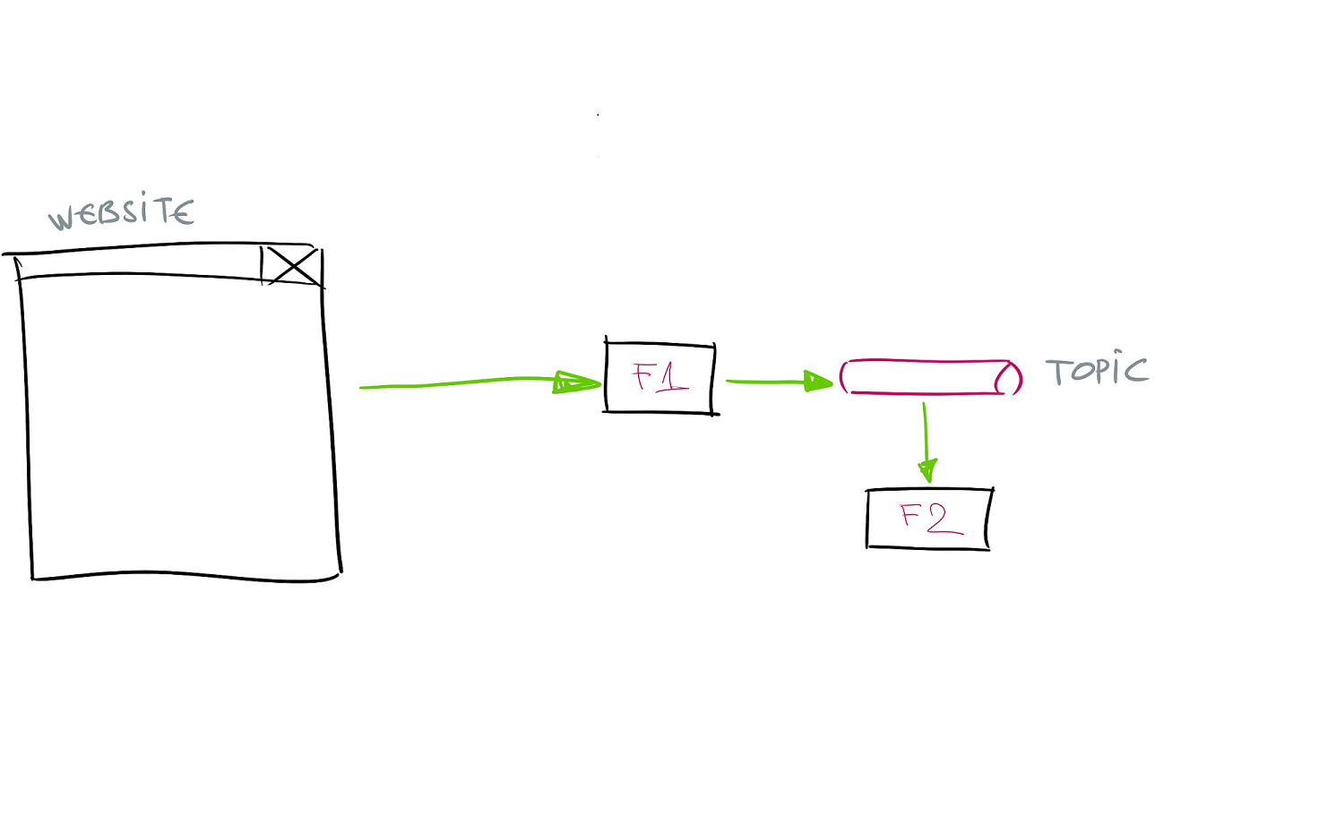

Slide 17
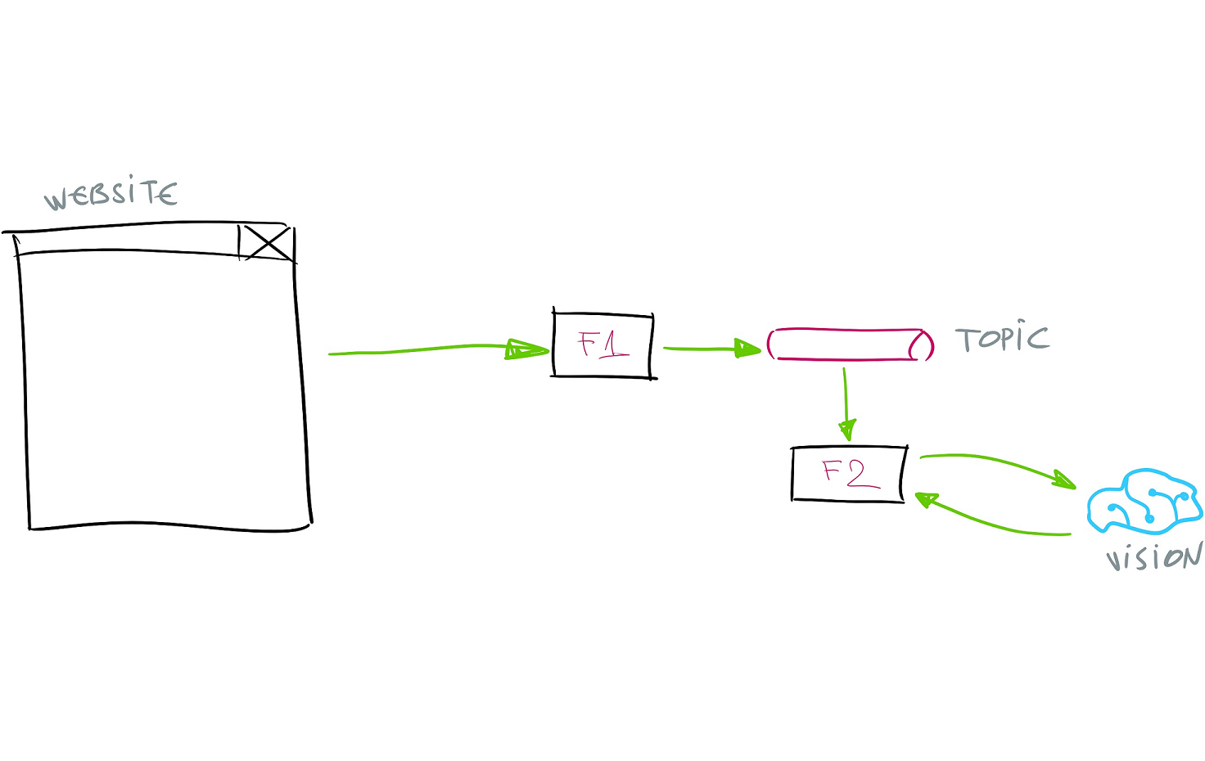

Slide 18


Slide 19





















Computer Vision
Speaker Regonition
Bing Web Search
Video Indexer
Speech Translation
Bing Custom Search
Custom Vision*
Text Analysis
Bing Video Search
Face
Bing Spell Check
Bing Image Search
Content Moderator
Language Understanding
Bing Visual Search
Speech to Text
Translator Text
Bing Entity Search
Text to Speech
QnA Maker
Bing News Search

Slide 21
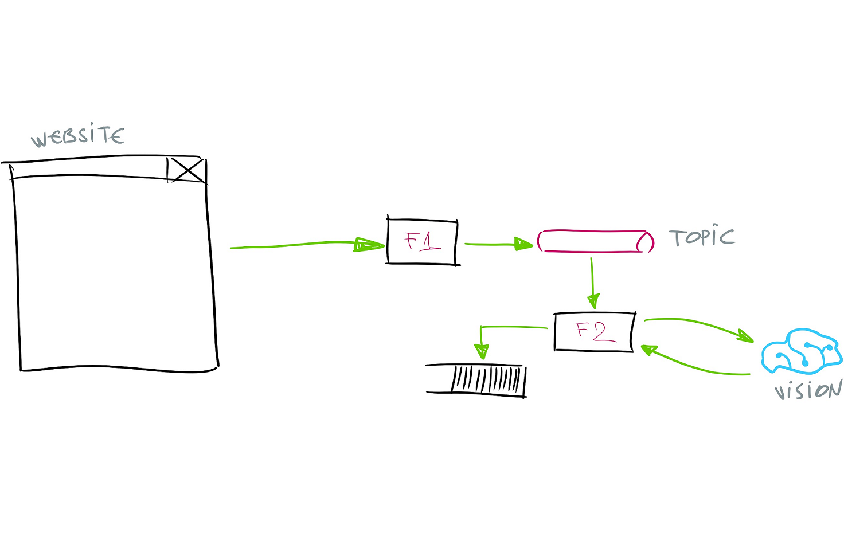

Slide 22
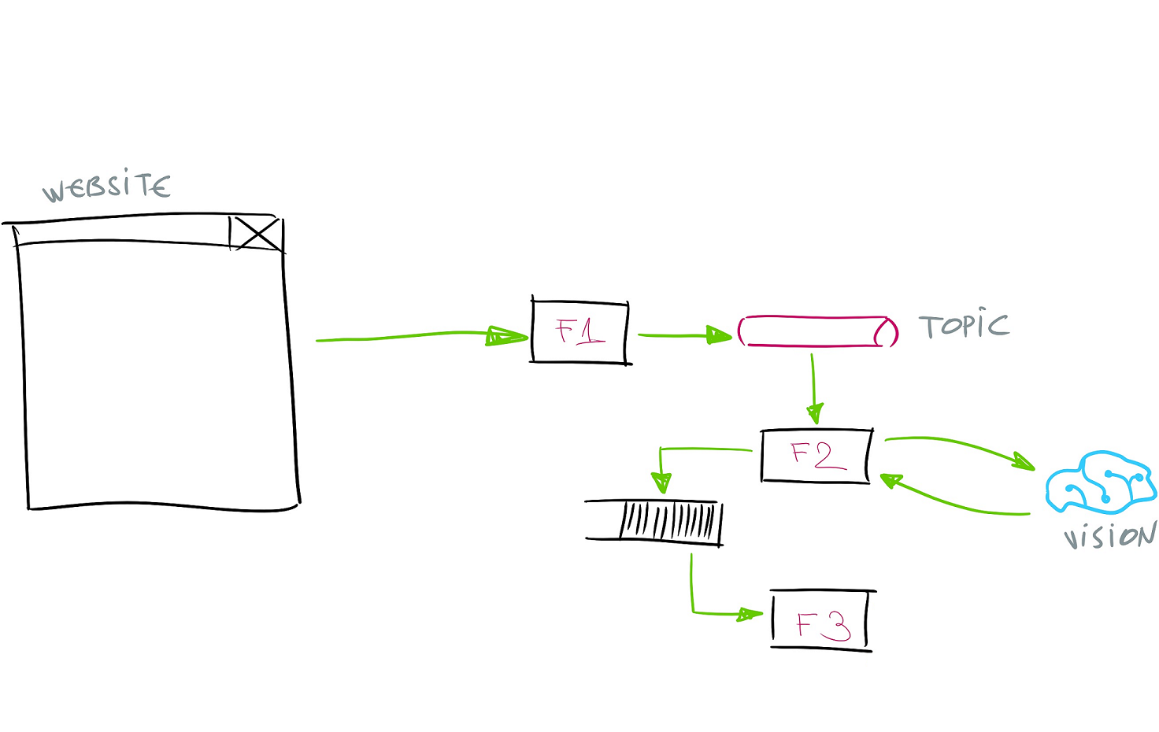

Slide 23
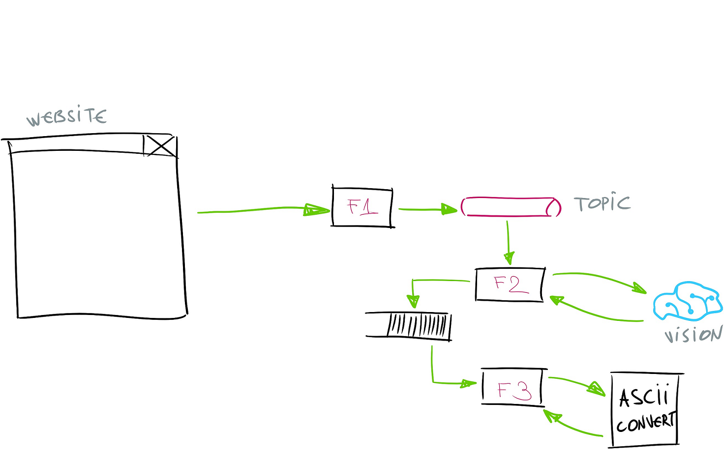

Slide 24
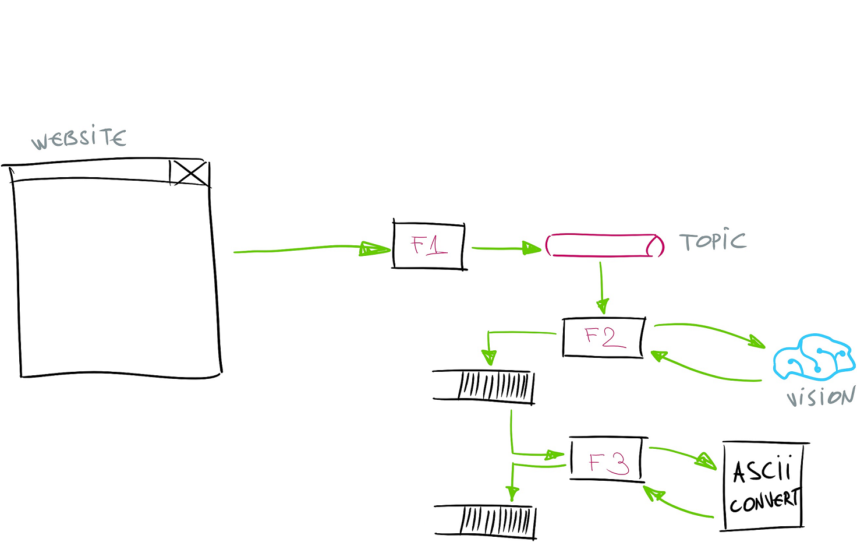

Slide 25
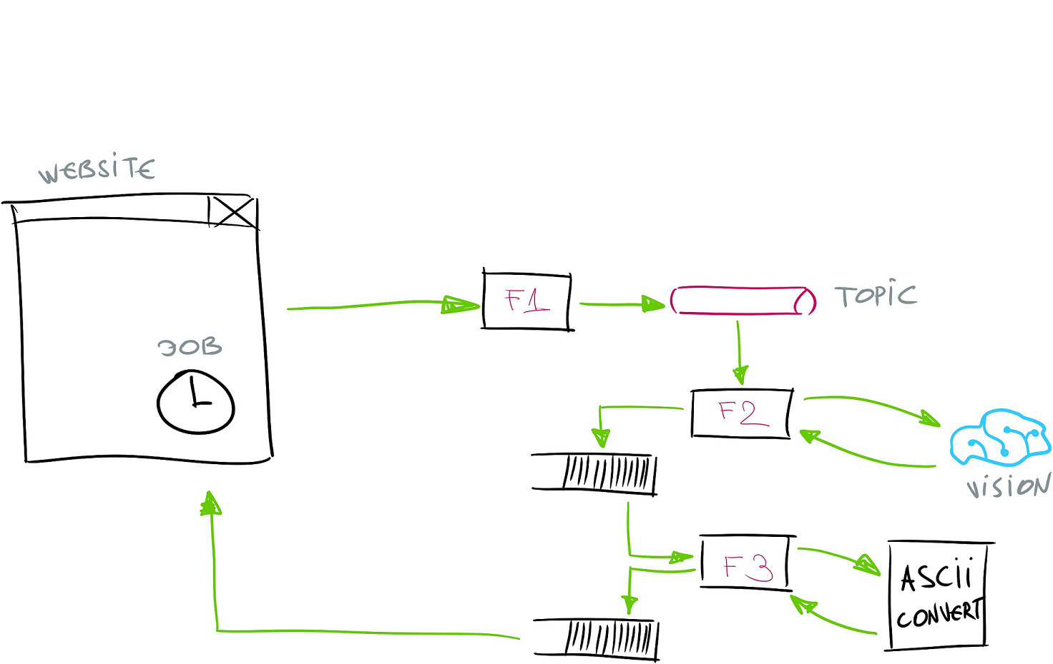

Slide 26
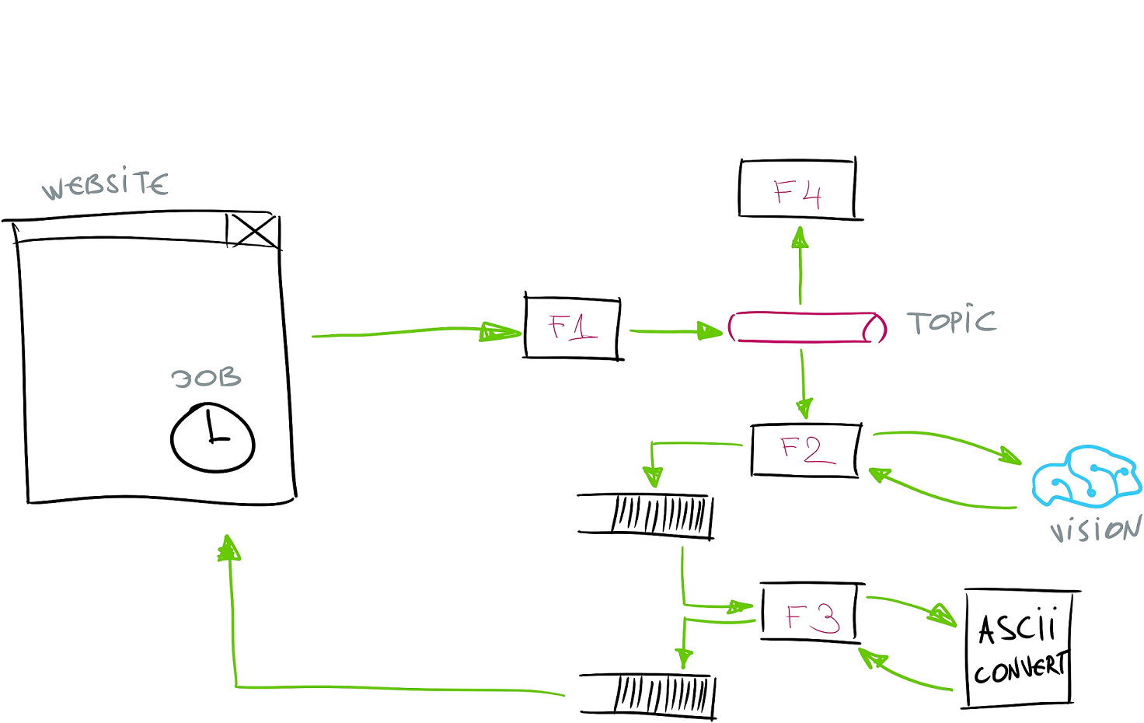

Slide 27
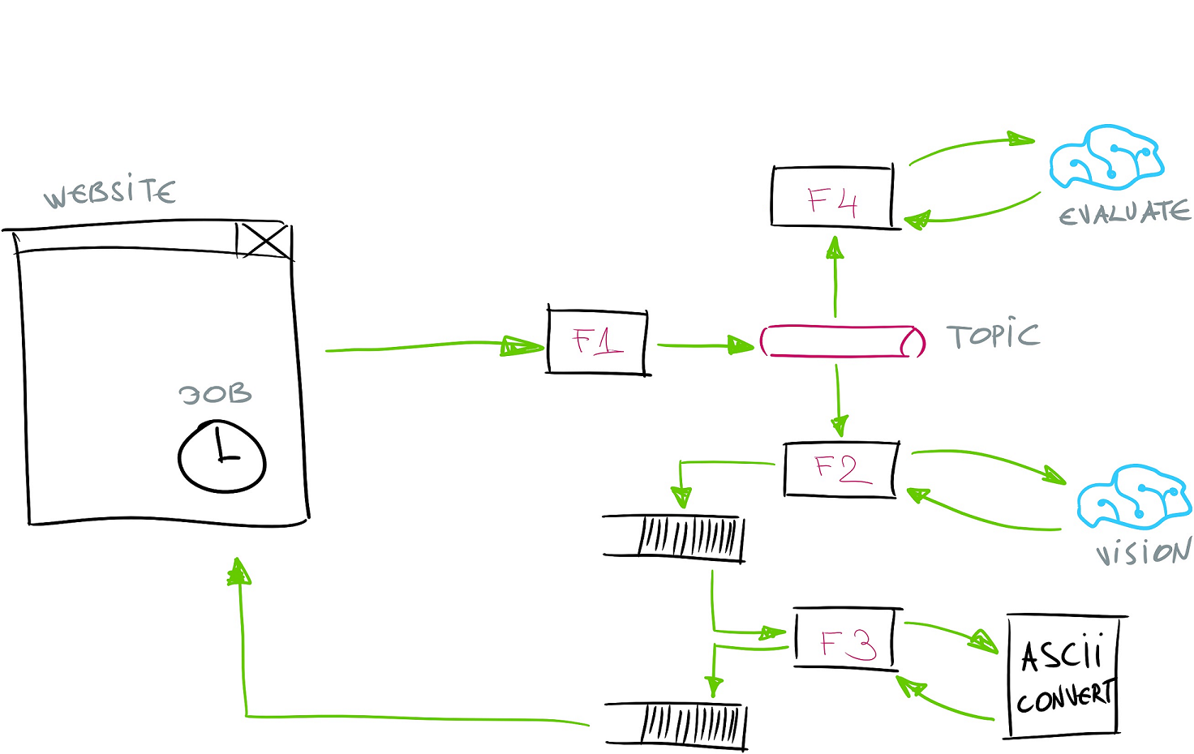

Slide 28
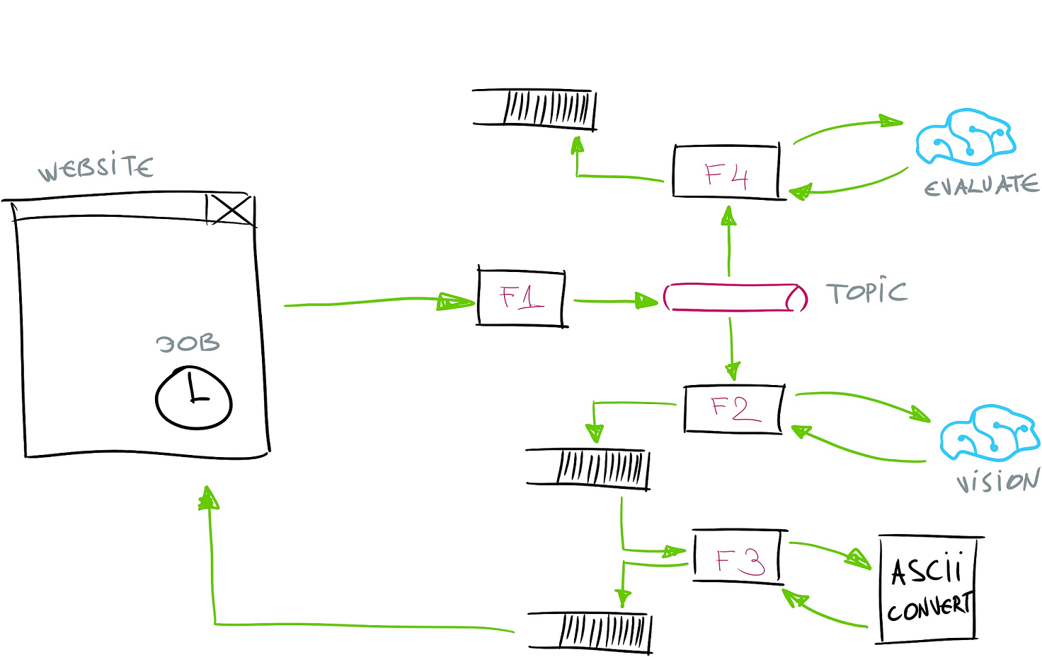

Slide 29
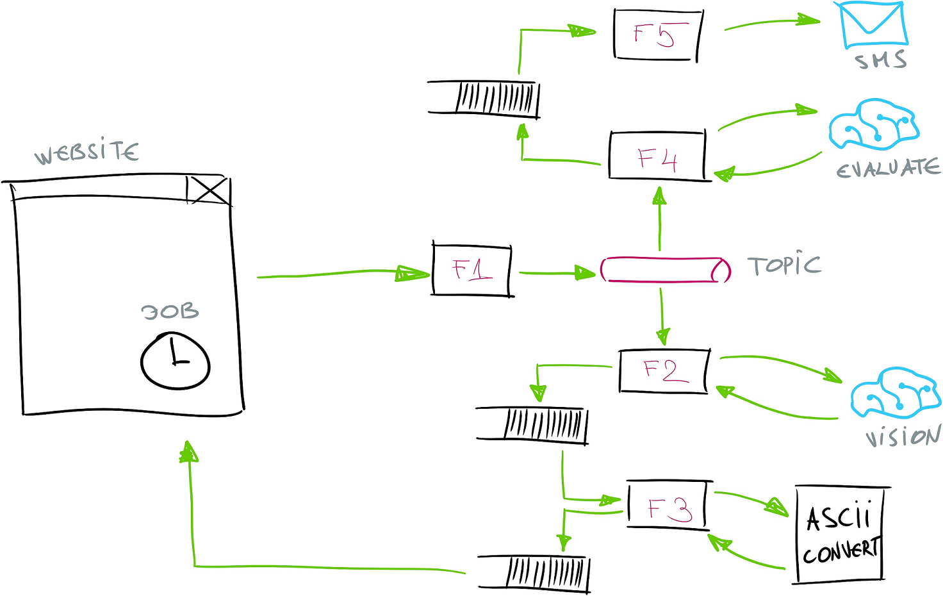

Slide 30
Azure Functions Billing
Notes:
H

Slide 31
> Consumption Plan
> Dedicated (App Service Plan)
Notes:
H

Slide 32
Benefits
Notes:
H

Slide 33
Scaling Costs
Reduced Operational Costs
Easier Management
Notes:
H
* - somebody takes care of your stuff
* - built used other services (commoditized)
* - Pay only for what you need
* - typical enterprise server utilizes only 5-15% of CPU / per year
* -

Slide 34
Drawbacks
Notes:
V

Slide 35
Vendor Lock-in
No In-server State
Startup Latency (Cold Start)
Execution Duration
API Endpoint Versioning (AzFunc Proxies)
Notes:
V

Slide 36
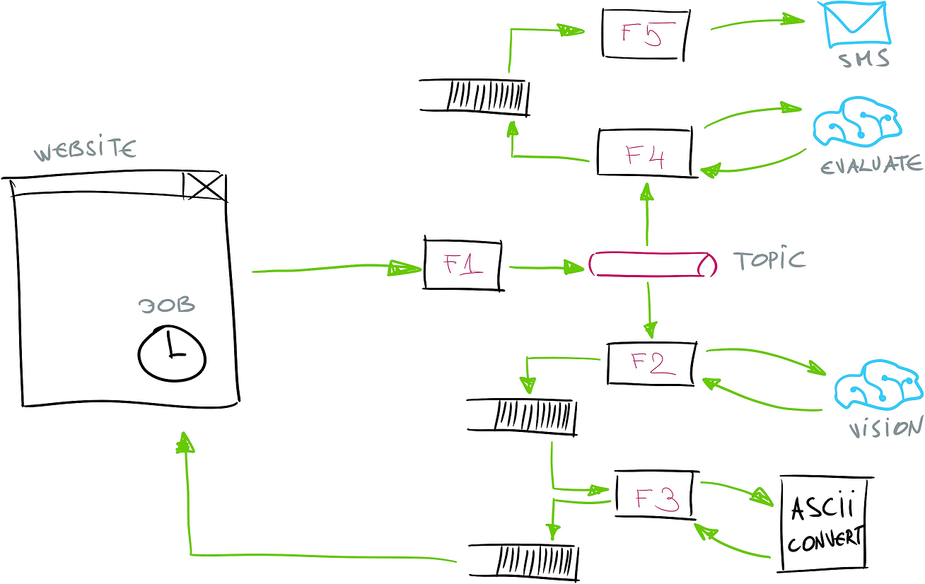




Slide 37
Durable Functions
Notes:
V

Slide 38
#r "Microsoft.Azure.WebJobs.Extensions.DurableTask"
public static async Task<AsciiArtResult>
Run(DurableOrchestrationContext context)
{
...
var analysisRequest = new AnalysisReq
{
BlobRef = outBlob.Name,
Width = request.Width
};
var resultFromF2 = await context.CallFunctionAsync<AsciiArtResult>(
"Function2",
analysisRequest);
...
return resultFromF2;
}
Notes:
V

Slide 39
#r "Microsoft.Azure.WebJobs.Extensions.DurableTask"
public static async Task<AsciiArtResult>
Run(DurableOrchestrationContext context)
{
...
var analysisRequest = new AnalysisReq
{
BlobRef = outBlob.Name,
Width = request.Width
};
var resultFromF2 = await context.CallFunctionAsync<AsciiArtResult>(
"Function2",
analysisRequest);
...
return resultFromF2;
}
Notes:
V

Slide 41
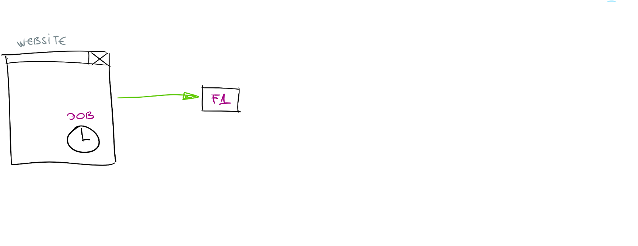

Slide 42
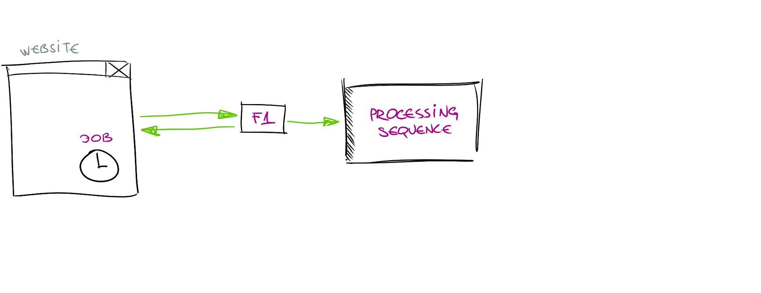

Slide 43
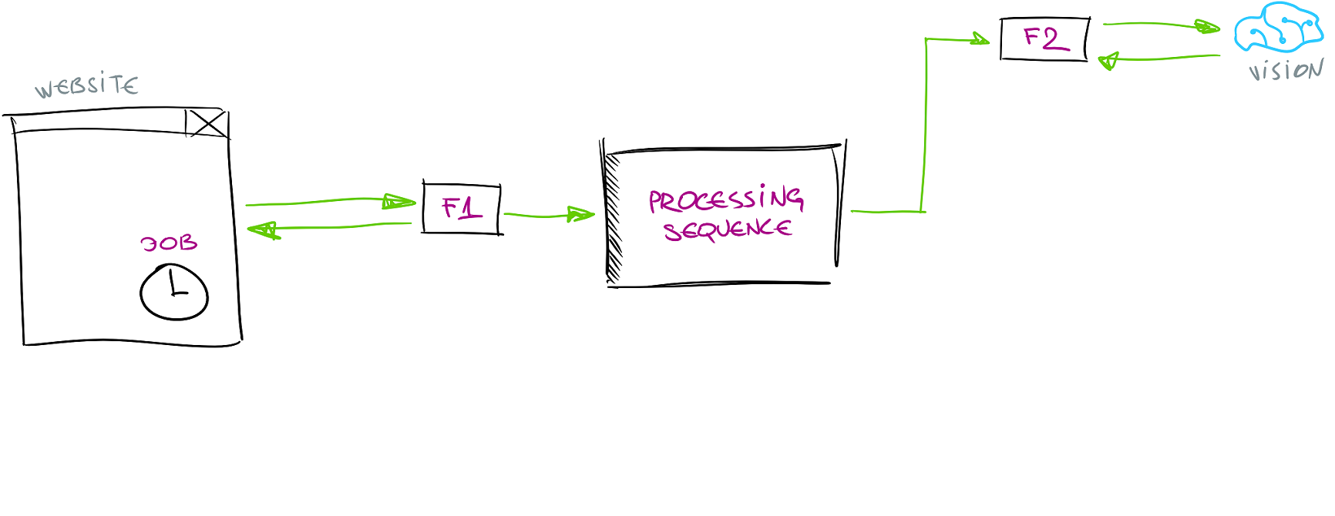

Slide 44
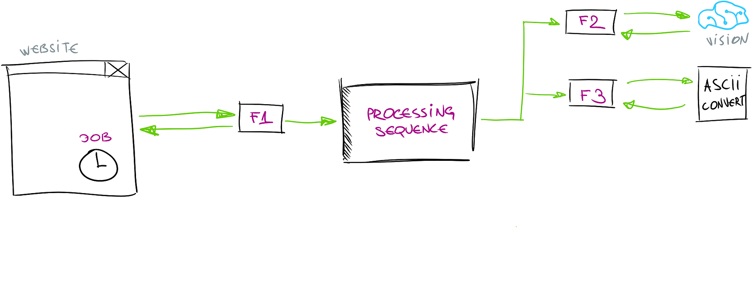

Slide 45
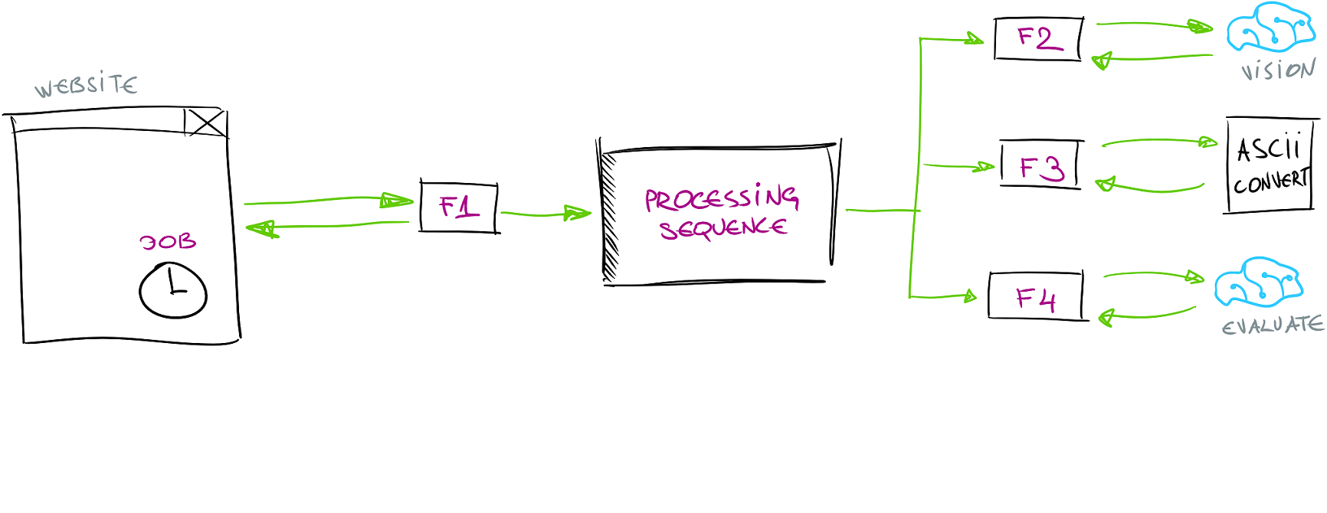

Slide 46
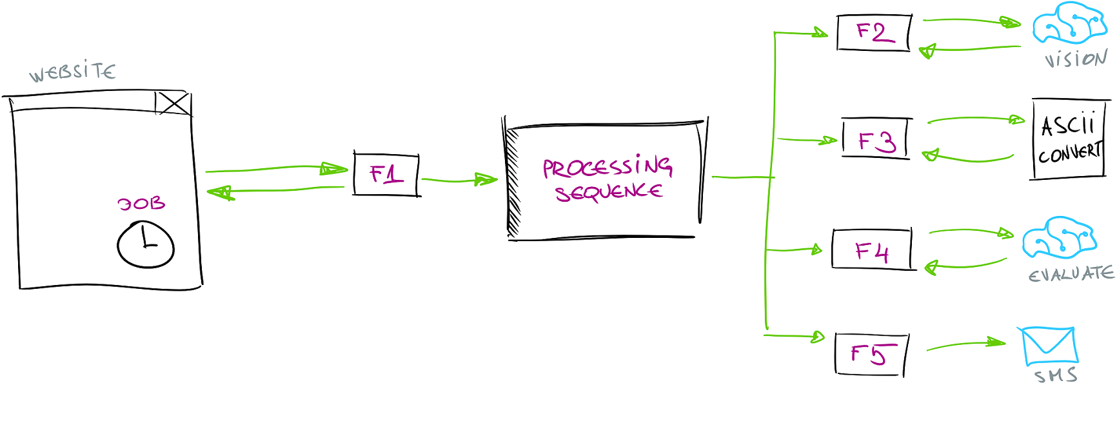

Slide 47
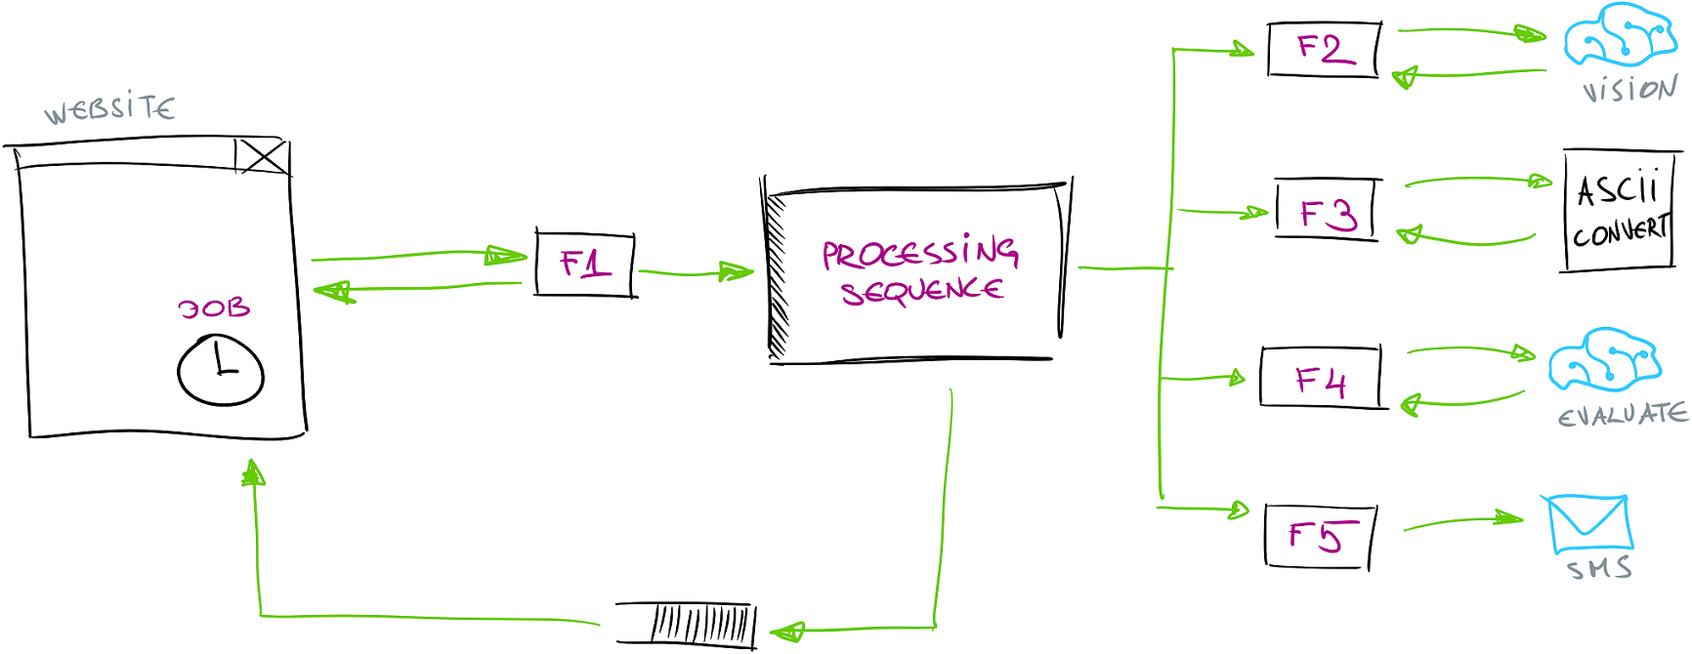

Slide 48
Cognitive Services Bindings
Notes:
V
https://functions-visualizer.azurewebsites.net/

Slide 49
public static async Task<CloudQueueMessage> Run(...)
{
var subscriptionKey = ConfigurationManager.AppSettings["cognitive-services-key"];
var serviceUri = ConfigurationManager.AppSettings["cognitive-services-uri"];
var client = new ComputerVisionClient(new ApiKeyServiceClientCredentials(subscriptionKey))
{
Endpoint = serviceUri
};
var result = await client.AnalyzeImageInStreamAsync(inBlob,
new[]
{
VisualFeatureTypes.Categories,
VisualFeatureTypes.Color,
VisualFeatureTypes.Description,
VisualFeatureTypes.Faces,
VisualFeatureTypes.ImageType,
VisualFeatureTypes.Tags
});

Slide 50
PM> Install-Package
AzureFunctions.Extensions.CognitiveServices*
* - only in v2

Slide 51
public static class Function2
{
public static async Task<CloudQueueMessage> Run(
[ServiceBusTrigger("mytopic", "to-ascii", AccessRights.Manage)] AnalysisReq request,
[Blob("%input-container%/{BlobRef}", FileAccess.Read)] Stream inBlob,
[VisionAnalysis(Key = "%VisionKey%",
Url = "%VisionUrl%")] VisionAnalysisClient client,
TraceWriter log)
{
var result = await client.AnalyzeAsync(new VisionAnalysisClient(inBlob)
{
Options = VisualAnalysisOptions.Categories |
VisualAnalysisOptions.Color |
VisualAnalysisOptions.Description |
VisualAnalysisOptions.Faces |
VisualAnalysisOptions.ImageType |
VisualAnalysisOptions.Tags
});

Slide 52
How to draw diagram for serverless apps?
Notes:
H

Slide 54
Functions Visualizer
Notes:
V
https://functions-visualizer.azurewebsites.net/

Slide 55
functions-visualizer.azurewebsites.net*

Slide 56
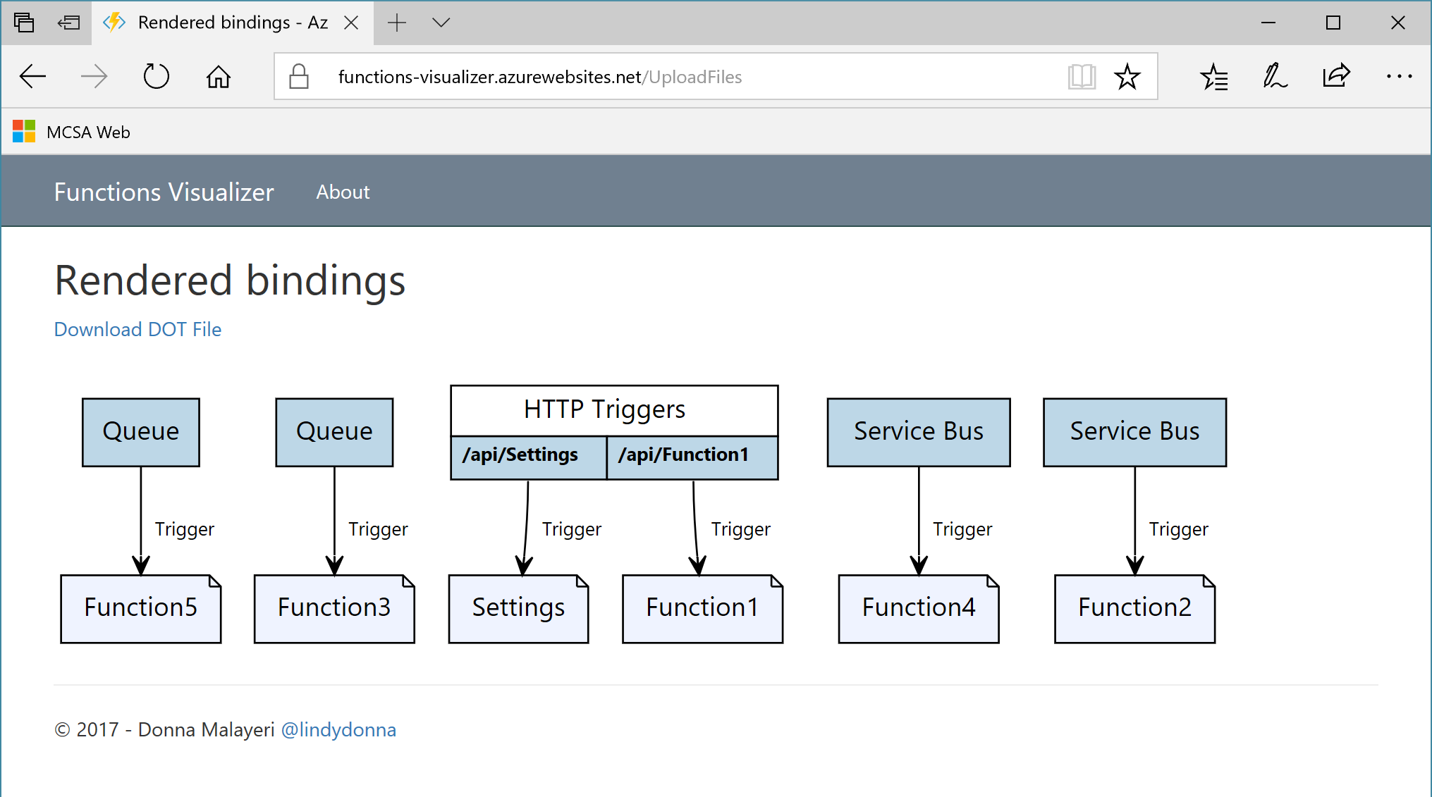

Slide 57
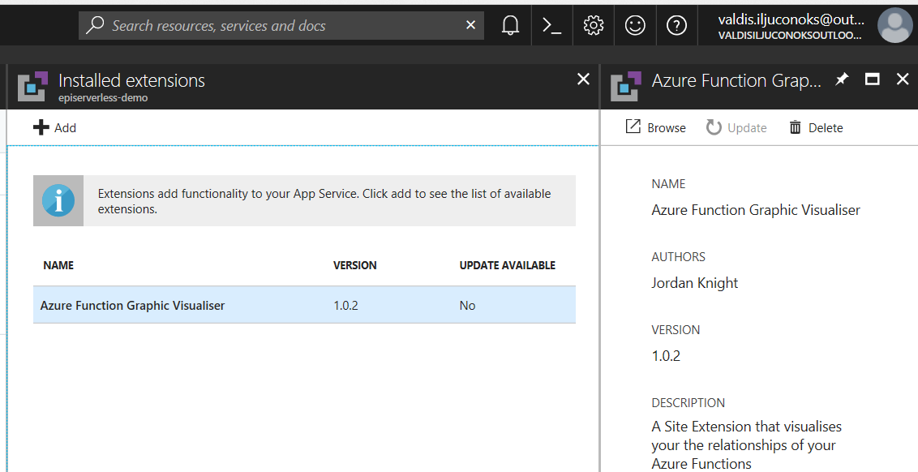

Slide 58
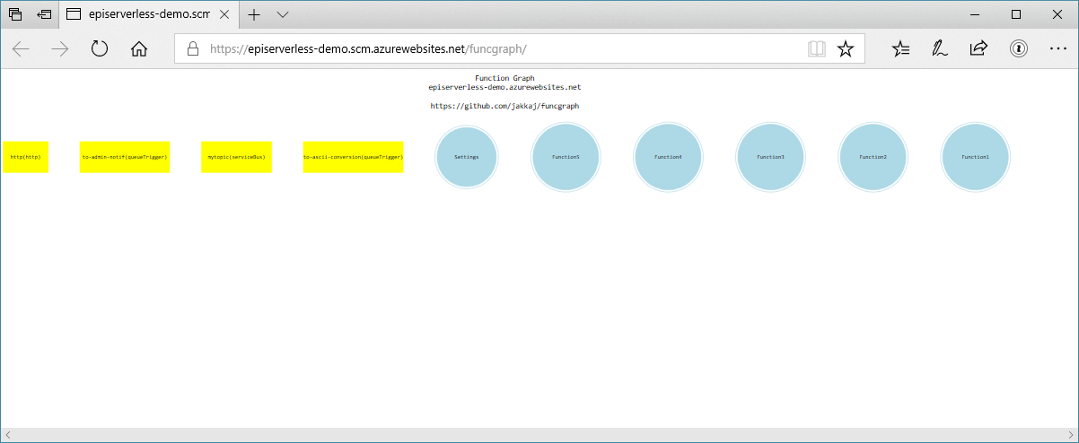

Slide 59
Functions Best Practices
Notes:
H

Slide 60
Single thing (* not necessarily simple)
Defensive (survive duplicates)
Share connections
Persistant storage across functions
Finish ASAP or die
Notes:
H

Slide 61
valdis iljuconoks (aka technical fellow)
tech guy at getadigital.com
(Microsoft .Net + EPiServer) ◦ MVP
@tech_fellow

